Slide 1

DEPARTMENT OF ELECTRONICS & COMMUNICATION ENGINEERING
1156EC701-MAJOR PROJECT
WINTER SEMESTER (2022-2023)
FIRST REVIEW
“DESIGN AND DEVELOPEMENT OF AI DRIVEN E NOSE SYSTEM FOR QUALITY ANALYSIS IN APPLE”
SUPERVISED BY
Dr.E.D KANMANI RUBY
Professor
PRESENTED BY
1.K.V.SASI KIRAN REDDY (11572)(19UEEC0272)
2. Y.V.SRI CHARAN REDDY (11823)(19UEEC0630)
3. Y.MAHESWARAREDDY (11571)(19UEEC0645)

Slide 2
TABLE OF CONTENTS
ABSTRACT
INTRODUCTION
LITAREATURE SURVEY
OBJECTIVE
BLOCK DIAGRAM
METHODOLOGY
TIME PLAN
CONCLUSION
FUTURE WORK
REFERENCES

Slide 3
ABSTRACT
Food spoilage is a significant problem in the food industry, causing significant economic losses and posing health risks to consumers. One common type of food spoilage is the decay of fresh fruits such as apples, which can be caused by a variety of factors, including microbial growth, physical damage, and exposure to oxygen. In this project, we propose the use of artificial intelligence (AI) to develop a system for the detection of fresh and rotten apples in the food industry.
The system will use machine learning algorithms to analyse images of apples and classify them as fresh or rotten based on their visual appearance. The system will be developed using a dataset of images of apples, both fresh and rotten, that have been collected from different sources in the food industry. The model, which will learn to classify apples based on their visual features. After that depends on sensor based reading signals output decision will be taken.

Slide 4
INTRODUCTION
To revolutionize the food industry by providing a more efficient and accurate method for detecting food spoilage.
By identifying rotten apples early in the supply chain, food waste can be reduced, and the risk of foodborne illness can be minimized. Additionally, the system can provide valuable information to food producers and retailers about the quality of their products, allowing for better decision-making and increased customer satisfaction.
Overall, this project demonstrates the potential of AI and machine learning in addressing critical challenges in the food industry, such as food spoilage detection, and has significant implications for improving food safety and reducing waste.

Slide 5
LITERATURE REVIEW
S.NO | TITLE OF THE PAPER/JOURNOL | AUTHOR DETAILS | INFERENCE
1 | Meat Quality Assessment by Electronic Nose (Machine Olfaction Technology) | Ghasemi-Varnamkhasti, M., Mohtasebi, S. S., Siadat, M., & Balasubramanian, S. (2009). Meat quality assessment by electronic nose (machine olfaction technology). Sensors, 9(8), 6058-6083. | At present, the commercial gas sensor technologies comprise metal oxide semiconductors, metal oxide semiconductor field effect transistors, organic conducting polymers, and piezoelectric crystal sensors. Further sensors based on fibreoptic, electrochemical and bi-metal principles are still in the developmental stage.
2 | Development of an Integrated Soft E-Nose for Food Quality Assessment | Pulluri, K. K., & Kumar, V. N. (2022). Development of an Integrated Soft E-nose for Food Quality Assessment. IEEE Sensors Journal, 22(15), 15111-15122. | In this paper, an integrated soft E-nose methodology focusing on performance enhancement and complexity reduction is proposed and implemented for the effective classification of beef quality and prediction of microbial population in beef. The soft E-nose methodology is tested on 18 available datasets.

Slide 6
OBJECTIVE
The proposed system should be able to accurately detect the quality of fruits and provide an automated solution for food quality control and inspection
To design and development an e-nose for analyzing the quality of apple with high accuracy.
To identify the sensors as per the chemical constituents present in the apple and design the sensor array of the e-nose system.
To design and develop an AI driven algorithm for predicting the quality of the apple for the processing system.

Slide 7
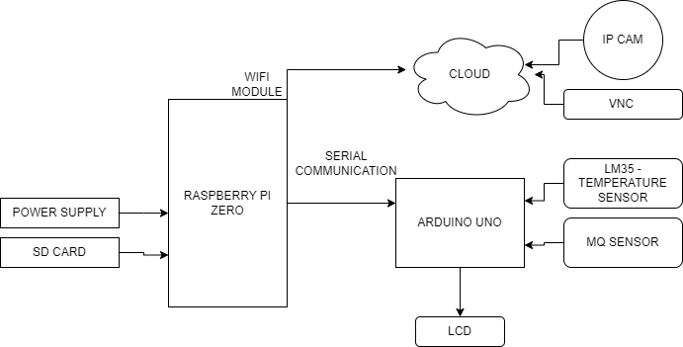
block diagram

Slide 8
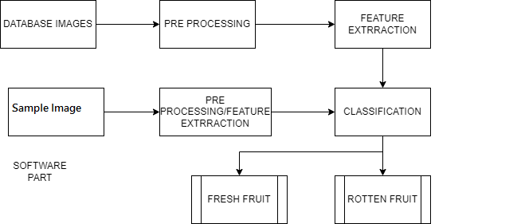
Block diagram

Slide 9
hardware
Raspberry pi zero
Arduino uno
Jumper wires
Power supply usb cable
LCD display
MQ sensor
Temperature sensor

Slide 10
software
Raspbian OS
Python IDLE
Arduino IDE
Embedded C
VNC viewer
Embedded C
Python
IP cam app

Slide 11
METHODOLOGY
Step 1: Selecting sensors that can detect a wide range of volatile compounds that are specific to apples and calibrating them for optimal performance.
Step 2:Sample collection and preparation: collecting apples from different stages of ripeness and preparing them for testing by removing any external contaminants.
Step 3: Selection and calibration of appropriate sensors and designing sensor array.
Step 4: Data acquisition and analysis: acquiring data from the sensors and analyzing it to determine the quality and ripeness of the apples.
Step 5: Design of Deep learning algorithm for the processing unit to predict the quality of the apple.
Step 6: Validation of the e-nose system: validating the e-nose system by comparing its results with those obtained from other testing methods.
Step 7: Refining and improving the e-nose system: continuously refining and improving the e-nose system based on the results of validation and user feedback.

Slide 12
PROJECT TIME PLAN
S.NO | PROJECT ACTIVITY | DESCRIPTION | DATE OF COMPLETION
1 | Topic Review | Methodology of the project | 21/01/2023
2 | Literature survey | The Survey on the project title from journal papers | 25/01/2023
3 | Review with Supervisor | Concept Discussion | 01/02/2023
4 | Basic methodology | How system works | 15/02/2023
5 | Methodology Implementation | Implementation of Proposed scheme | 25/02/2023
6 | Software implementation | Implementation of code | 10/03/2023
7 | Trial Run | Checking the result of the project | 20/03/2023

Slide 13
CONCLUSION
This project aimed to develop a system for detecting the freshness and ripeness of fruits based on their temperature using an LM35 sensor and a deep learning algorithm. Additionally, the proposed system aimed to classify fruits as organic or non-organic based on the readings obtained from an MQ sensor. The results of this project showed that the proposed method can accurately detect the quality of fruits, providing an automated solution for food quality control and inspection. The proposed system can potentially contribute to reducing food waste and improving the quality of food products in the food industry..

Slide 14
Furture work
Further research can be conducted to explore the scalability of the proposed system and to evaluate its performance in a real-world environment. This project demonstrates the potential of image classification technology in improving food quality in public schools. The proposed system has significant implications for food safety, waste reduction, and public health, and has the potential to be implemented in other food service industries

Slide 15
REFERENCES
[1] c. A. Medina, M. R. Perez, and L. C. Trujillo, ‘‘iot paradigm into the smart city vision: A survey,’’ in proc. IEEE int. Conf. Internet things (ithings) IEEE green comput. Commun. (Greencom) IEEE cyber, phys. Social comput. (Cpscom) IEEE smart data (smartdata), exeter, U.K., Jun. 2017, pp. 695–704.
[2] m. Umar and W. Uhl, ‘‘integrative review of decentralized and local water management concepts as part of smart cities (lowasmart),’’ norwegian inst. Water res., Oslo, norway, tech. Rep. 7058-2016, 2016.
[3] s. J. Livesley, V. Marchionni, P. K. Cheung, E. Daly, and D. E. Pataki, ‘‘water smart cities increase irrigation to provide cool refuge in a climate crisis,’’ earth’s future, vol. 9, no. 1, jan. 2021. E2020ef001806
.

Slide 16
[4] l. D. Moro, L. D. Gasperina, R. V. Pagnussat, and L. L. Brandli, ‘‘urban gardens: possibilities of integration with smart practices,’’ in water, energy and food nexus in the context of strategies for climate change mitigation. 2020, pp. 47–58, ch. 4.
[5] l. D. Moro, L. D. Gasperina, R. V. Pagnussat, and L. L. Brandli, ‘‘urban gardens: possibilities of integration with smart practices,’’ in water, energy and food nexus in the context of strategies for climate change mitigation. Cham, switzerland: springer, 2020, pp. 47–58.
[6] p. Fraga-lamas, M. Celaya-echarri, L. Azpilicueta, P. Lopez-iturri, F. Falcone, and T. M. Fernández-caramés, ‘‘design and empirical validation of a lorawan iot smart irrigation system,’’ multidisciplinary digit. Publishing inst. Proc., Vol. 42, no. 1, p. 62, 2020, doi: 10.3390/ecsa-6-06540

Slide 17



